Slide 1

Sravan Chowdary Vuppalapati
DATA 606 FINAL PROJECT
Washington DC Felony Sentences
Unger the guidance
of
Dr. Chaojie Wang
Campus ID: QI57017

Slide 2
ABSTRACT
ABSTRACT
Felonies have been a major concern in the US in the recent times. Young population are being involved in crime intentionally or unintentionally. Unlike counties , we see many day-to-day crimes in the headlines in the downtowns of major cities. It might be due to lack of awareness of the laws or because of the environment they might be in. But one has to know the repercussions for any wrongdoing one commits. My objective is to let people know what crime they are doing and what sentence they get depending on their age and crime they have committed.

Slide 3

Objective
To predict the months of sentence and classify the sentence type of offense depending on the offense, age, offense category and severity group.

Slide 4
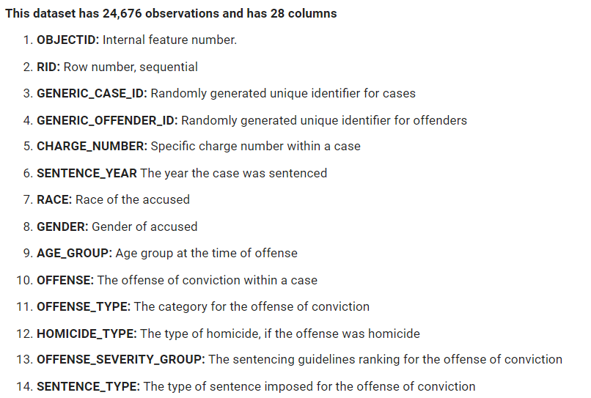
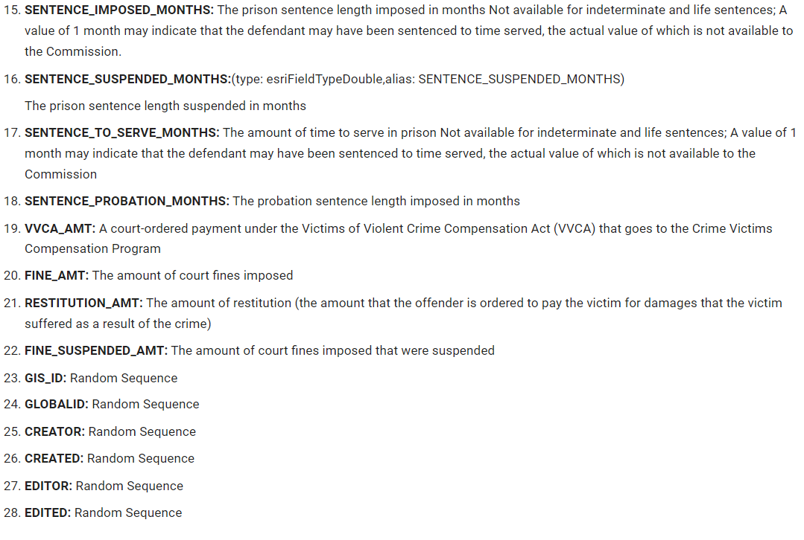
DATASET DESCRIPTION
This dataset has been retrieved from 'Open Data DC’.
This dataset contains all felony counts sentenced from 2010 onward and includes offender demographic information such as gender, race, and age, as well as sentencing information such as the offense, offense severity group, and the type and length of sentence imposed. The dataset is updated annually.
Link to Dataset: https://opendata.dc.gov/datasets/DCGIS::felony-sentences/explore

Slide 5
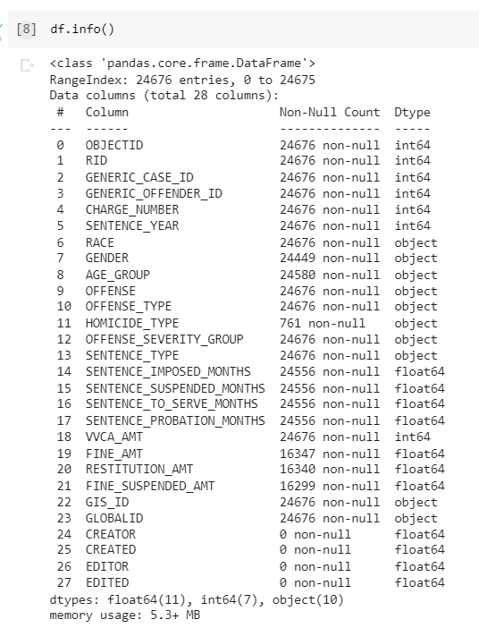
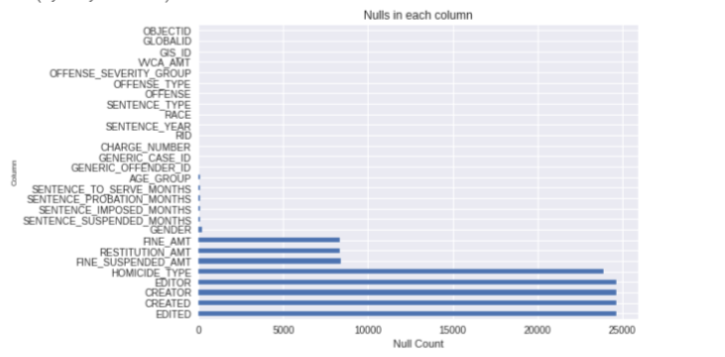
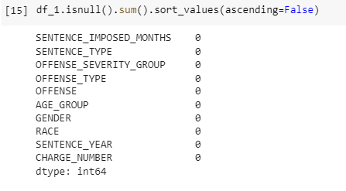
DATA CLEANUP

Slide 6
DATA CLEANUP
This dataset has 24,676 observations and 28 features.
I omitted 'GIS_ID','GLOBALID', 'CREATOR', 'CREATED', 'EDITOR', 'EDITED' columns because they don’t have significant information for analysis.
Columns 'OBJECTID', 'RID’, 'GENERIC_CASE_ID','GENERIC_OFFENDER_ID' are dropped because they are not continuous variables but random sequences.
Column 'HOMICIDE_TYPE' can be used for analysis but is dropped because it has almost 22000 nulls. Even if we impute, its values will be duplicated.
'VVCA_AMT','FINE_AMT', 'RESTITUTION_AMT', 'FINE_SUSPENDED_AMT' are dropped since my objective is to predict the sentence type and not the amount to be imposed.

Slide 7
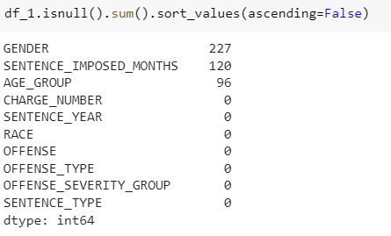
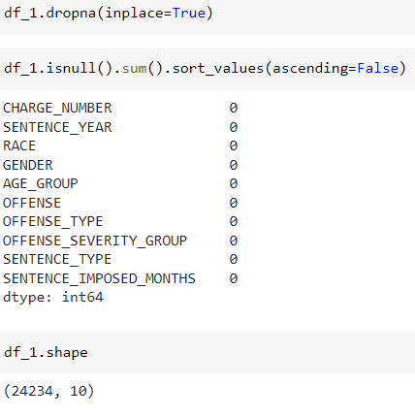
DATA CLEANUP
So, final data has 24324 rows and 10 columns

Slide 8
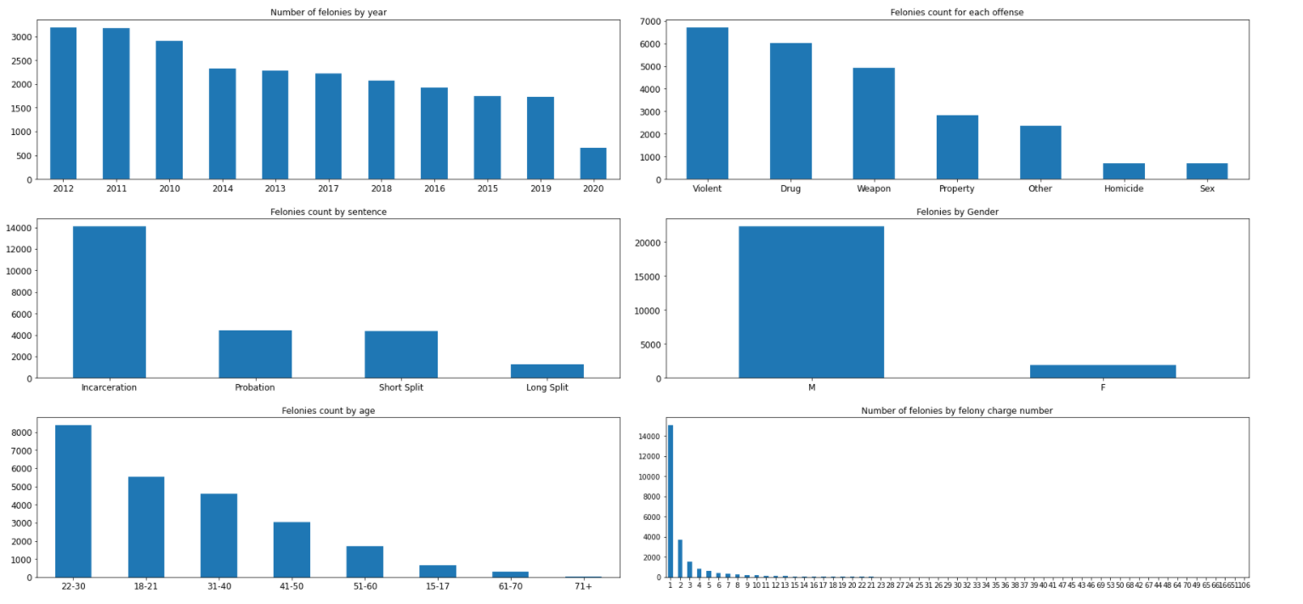
Exploratory Data Analysis

Slide 9
Number of felonies by year: From the distributions, we can observe that the number of felonies have decreased over time. This might be due to the awareness among people or due to unreported cases.
Felonies count for each offense: Felonies by type 'violent' are the highest followed by type 'Drug’. Sex felonies are the least in DC from 2010 to 2020.
Felonies count by sentence: Incarceration is the most serious sentence type among all the felonies. Whereas the number of sentences for probation and short split are on par with each other. Long split is rarely sentenced.
Felonies by Gender: Male population has committed most number of felonies accounting around 22000 while Females accounted to low value of 3000.
Felonies by count by age: It is evident from the distribution that young people aged 18-30 are more tended to commit a crime compared to elders. Obviously, old aged people aged 71+ are not accused much.
Felonies by Number of felonies by felony charge number: This distribution shows the number of felonies by charge number. Charge number is nothing but severity of crime. People are often charged by number ‘1’.
Most of the features are negatively correlated to target variable "SENTENCE_TYPE".I think it is a good correlation because higher correlation might have masked the prediction.

Slide 10
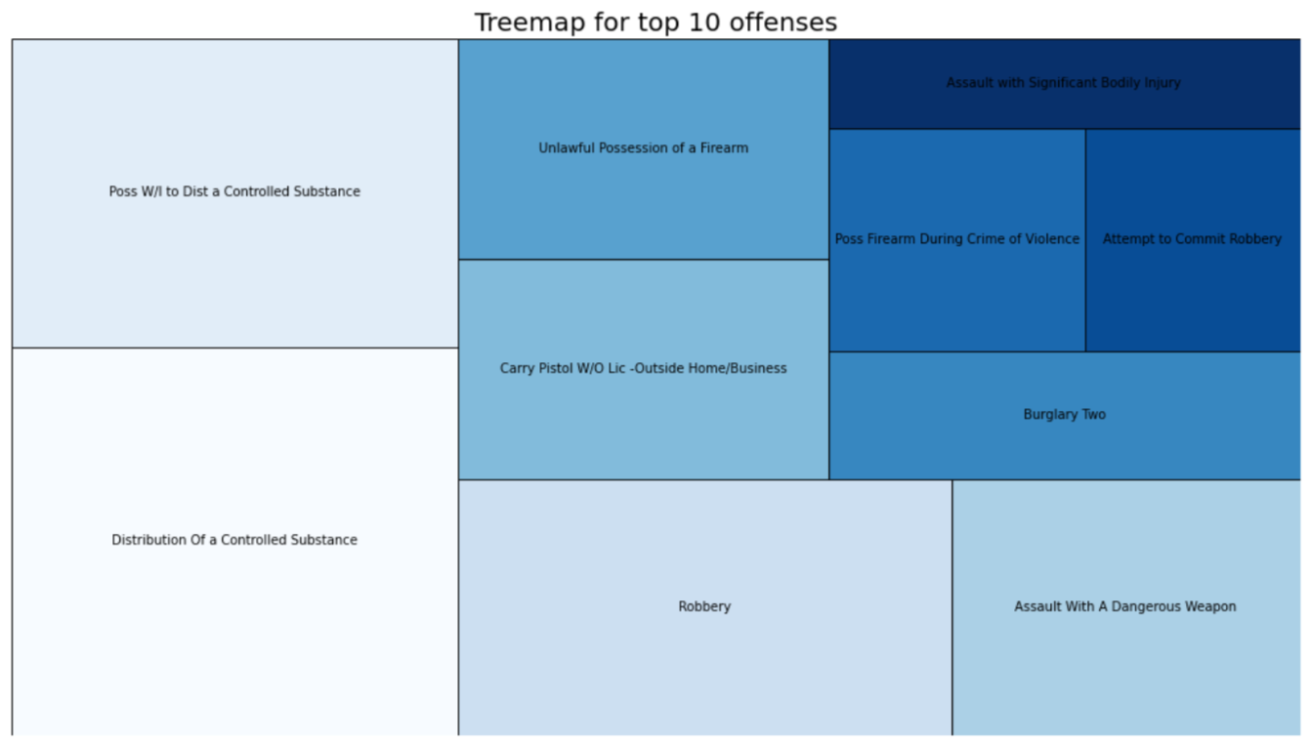
Exploratory Data Analysis
This tree map shows top ten offenses in Washington D.C. Assault is the offense people committed most often followed by robbery.
There are instances where people are charged with double offenses e.g., Possessing a firearm during violence.

Slide 11
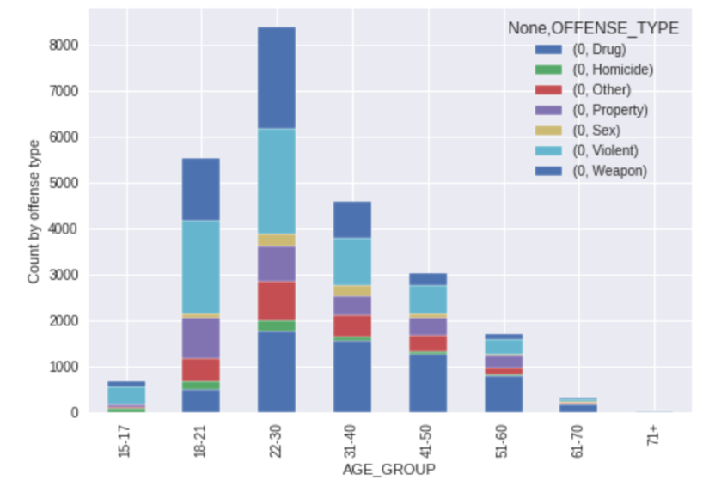
Exploratory Data Analysis
No of offense for an offense type in each age group
This stacked bar graph depicts the offense type for each age group. As explained earlier, people aged between 22-30 committed more crimes.
Of these, Drug and Violence categories share same number of sentences whereas sex , homicide share equal sentences. Similar trend can be seen for Property and Other categories.

Slide 12
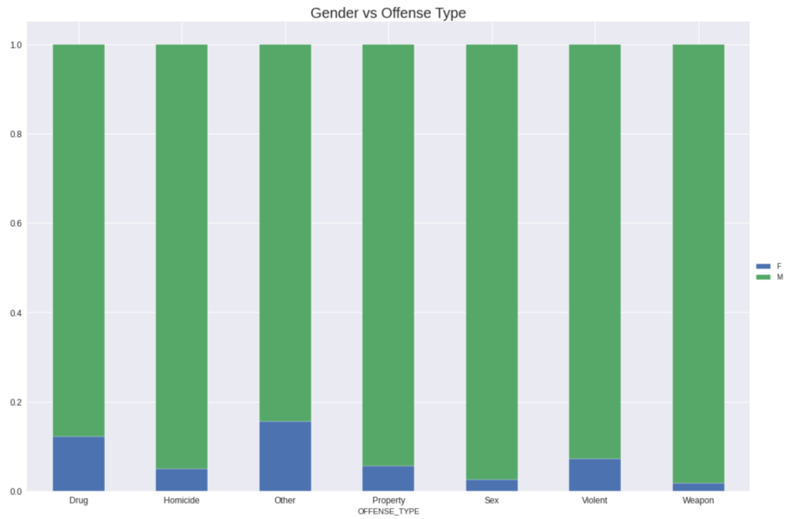
Exploratory Data Analysis
No of offenses by gender
This crosstab depicts the proportion of offenses committed by a gender for each category.
In all cases, Males committed more offenses than Females.

Slide 13
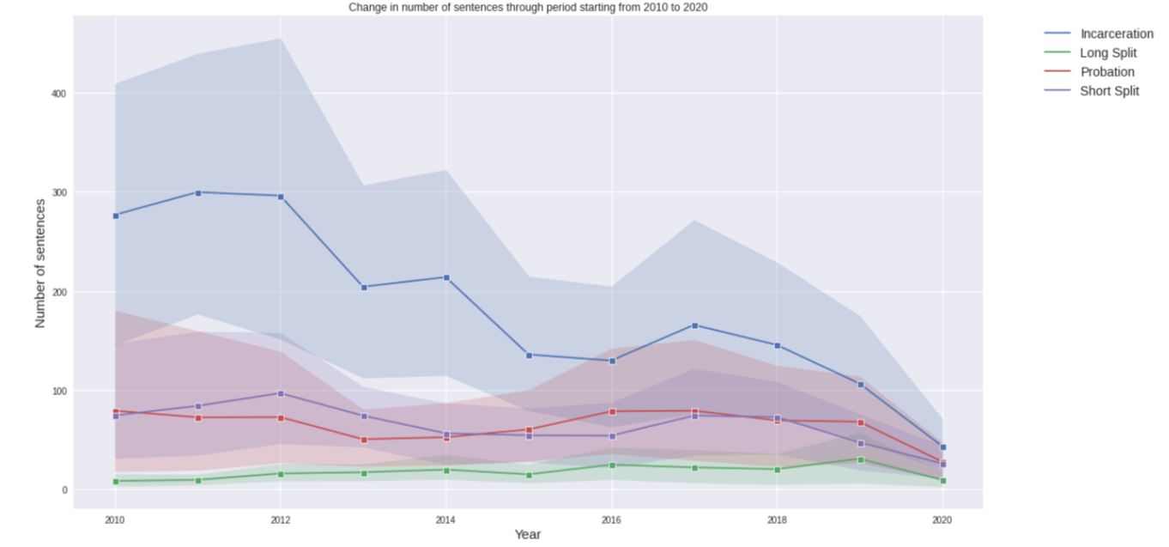
Exploratory Data Analysis
Change in number of sentences through period starting from 2010 to 2020

Slide 14
Exploratory Data Analysis
Change in number of sentences through period starting from 2010 to 2020
This line plot explains the change in number of cases over years.
People are mostly sentenced with incarceration (imprisonment for one year/more or even death).
No of incarcerations are high during the year 2010.But are gradually reduced over time.
Probation and Short Split sentences started at around 80 in 2010 and are constant until 2019 but suddenly declined in 2020.
Long Split has the least number of sentences, among others. It also followed a trend like Short Split are very low.

Slide 15
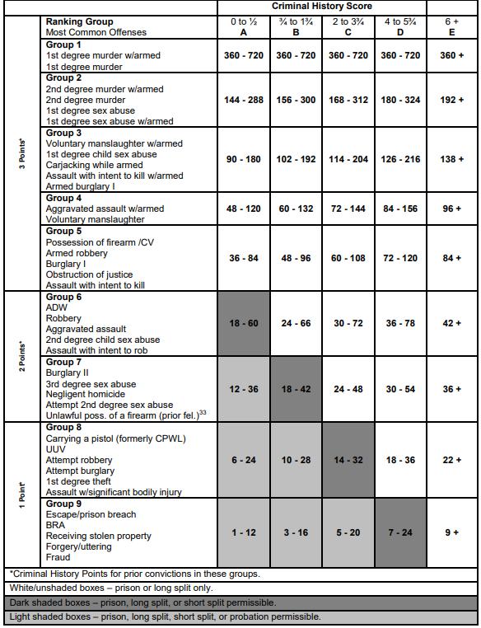
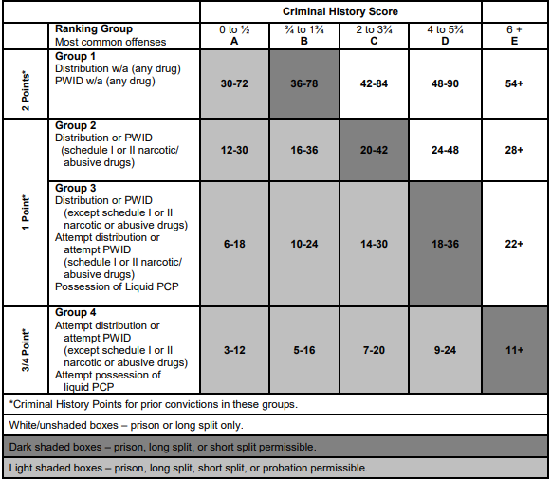
Exploratory Data Analysis
Master Grid
Drug Grid
PWID: Possession with intent to distribute
Liquid PCP: Angel Dust Drug

Slide 16
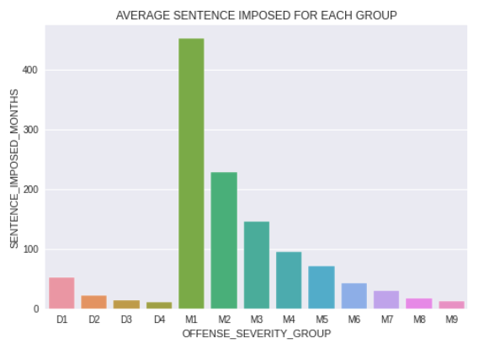
Exploratory Data Analysis
Average Sentence Imposed
The average sentence imposed is higher for Group M1 (First Degree Murder w or w/o armed) is higher among all other groups i.e., 451 months and least for D4 (Attempt distribution of a drug), 10 months.

Slide 17
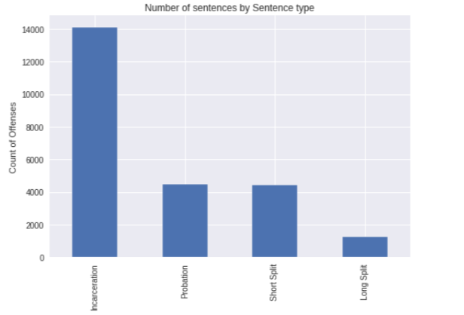
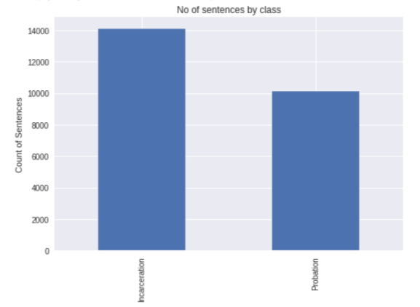
Feature Engineering
My objective is to predict sentence type. But the distribution of classes seams to be imbalanced. There are less samples for Long Split.
Short Split Sentence and Long Split means offenders serving some time in prison and some time outside depending on their behavior.
Probation also serves the same purpose.
So, I merged the Short Split and Long Split into Probation and thus making the class distribution balanced and making it a binary classification.

Slide 18
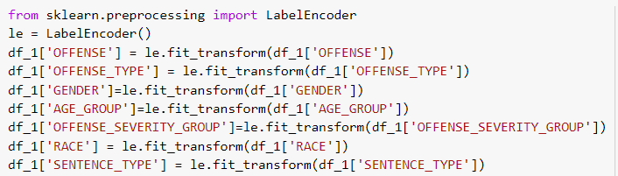
Feature Engineering
Since, there is a slight imbalance in the class data, I have done oversampling to negate the imbalance to some extent using SMOTE function
Most of my features are categorical and as a part of preprocessing, I had to label encode them for training.

Slide 19
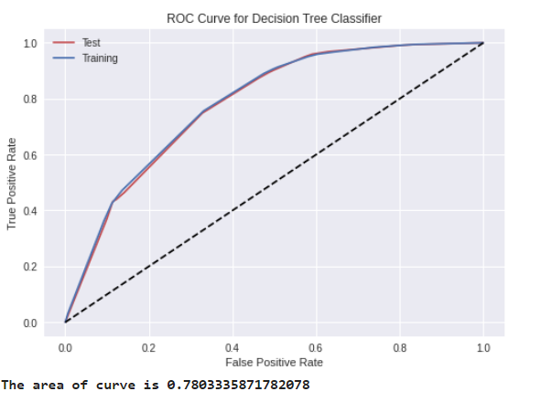
Classification of Sentence Type
Decision Tree Classifier
Hyperparameters Used: Used 1,2,3,4 as max_depths for grid search.
This model seems to be best for classification when hyperparameter max depth is 4
This model has 70.4% accuracy
Area under curve is 78%,but that's not enough for a good classification.

Slide 20
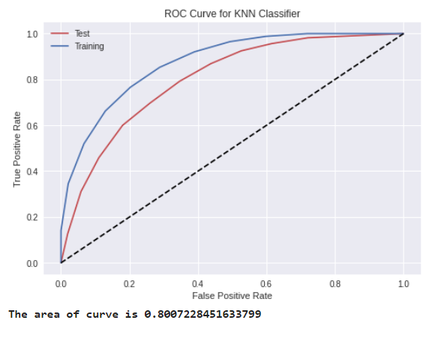
Classification
K-Nearest Neighbors
Hyperparameters Used: Used 1,4,6,10 as number of neighbors for grid search.
This model seems to be best for classification when hyperparameter number of neighbors are 10
It seems like KNN is has better accuracy (81%) compared to DTC
Also, the area of curve for KNN has also increased to 80%.

Slide 21
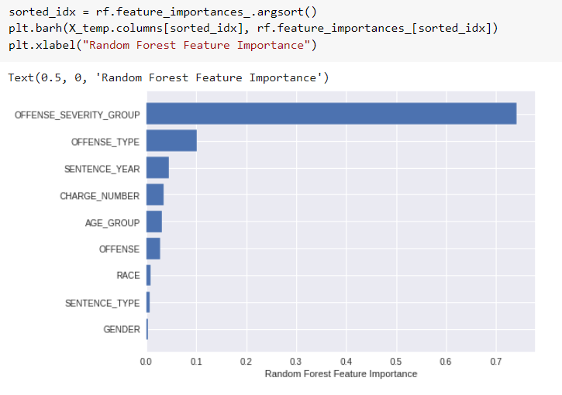
Prediction of No of Months Sentence Imposed
Due to less correlation between target variable(SENTENCE_IMPOSED_MONTHS) and input variables, I have selected input features depending on the feature importance.
So, my final input features for prediction are the top 5 features in the above bar graph.

Slide 22
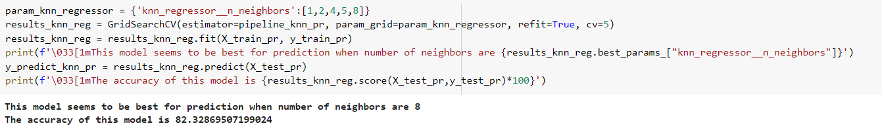
Prediction: KNN Regressor
KNN Regressor:
With a test train split of 80:20 and considering 8 nearest neighbors, this algorithm has an accuracy of 82.3%.

Slide 23
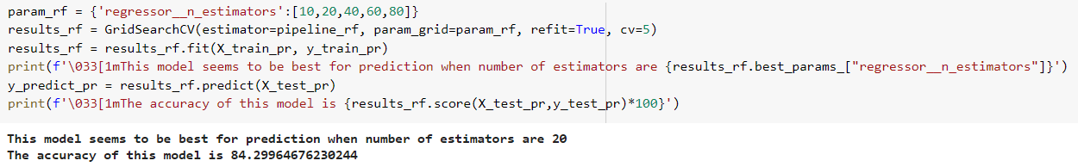
Prediction: Random Forest Regressor
Random Forest Regressor:
This model seems to be best for prediction when number of estimators are 20.
The accuracy of this model is 84.3%

Slide 24
References
https://machinelearningmastery.com/multinomial-logistic-regression-with-python/
https://medium.com/analytics-vidhya/how-to-carry-out-k-fold-cross-validation-on-an-imbalanced-classification-problem-6d3d942a8016
https://medium.com/geekculture/how-to-plot-a-treemap-in-python-48743061cfda
https://scdc.dc.gov/sites/default/files/dc/sites/scdc/publication/attachments/2016%20Voluntary%20Sentencing%20Guidelines%20Manual.pdf
https://scdc.dc.gov/page/glossary-001

Slide 25
THANK YOU

